Slide 1


PROJ NAME
VALUE PROP
ELSIE
ALIX
CONSTANCE
JIALIN
Sprout
Collaborators for an instant,
Connections for a lifetime.

Slide 2




Growth in the music industry revolves around networking.
But networking for small creators is either awkward or sparse.
Sprout offers a way to network that feels organic and genuine.
It is how creators come across breakthrough opportunities, learn from other talented artists, and expand their creative outlook.
Turned away by the tedious, disingenuous nature of a process that “feels like a means to an end,” small and new creators sacrifice attending to this crucial component to their success.
Musicians branch out by “seeding” sounds to be replied to and by putting their own musical spin on soundbytes seeded by other artists.
From these soundbyte seeds, networks fertilized by creativity and passion can sprout.

Slide 3









Post a soundbyte
[SIMPLE]
Reply to a soundbyte
[MODERATE]
Tasks
Connect with a remixer
[COMPLEX]
Track your soundbyte’s evolution
[COMPLEX]

Slide 4
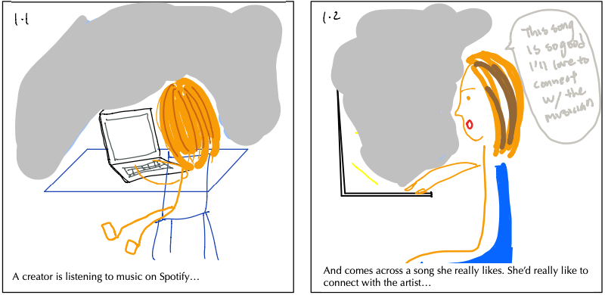
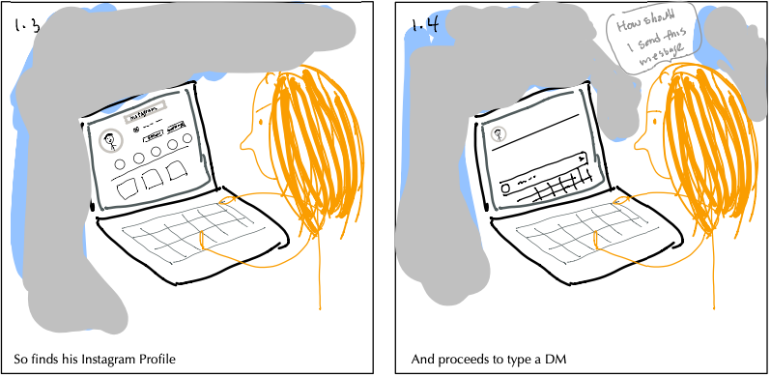
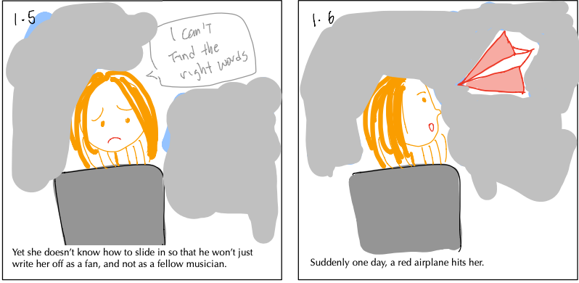
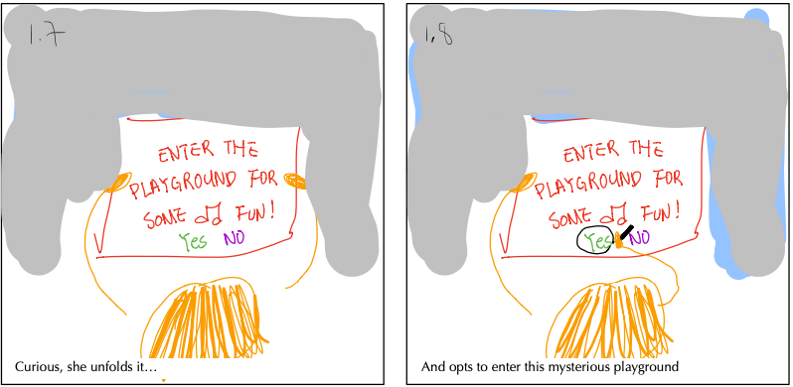
Post a soundbyte [SIMPLE]
Scene 1

Slide 5
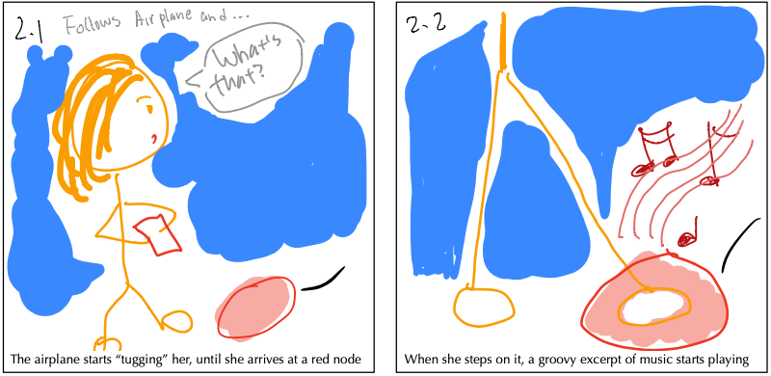
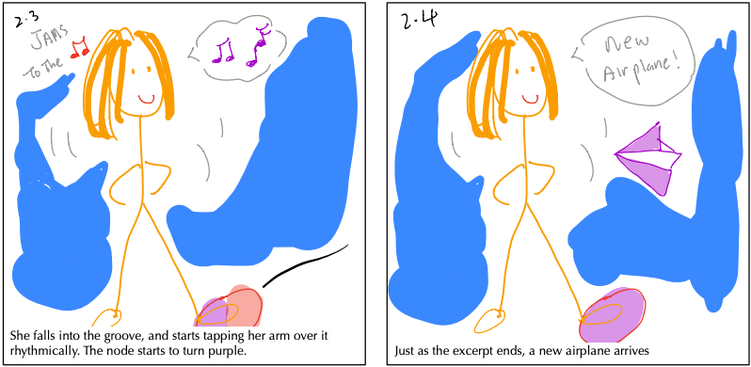
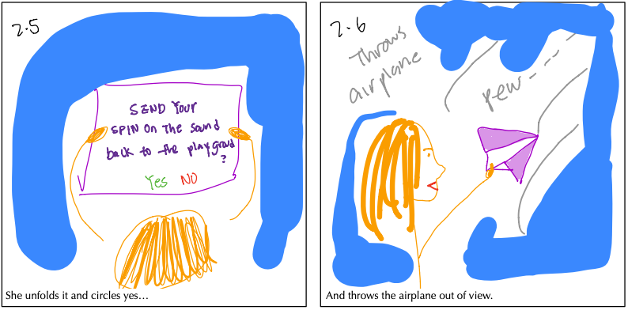
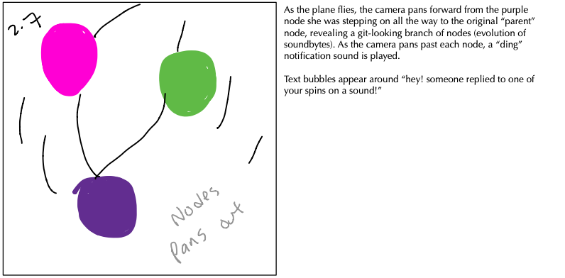
Reply to a soundbyte [MODERATE]
Scene 2

Slide 6
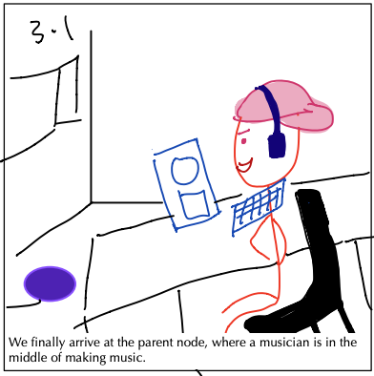
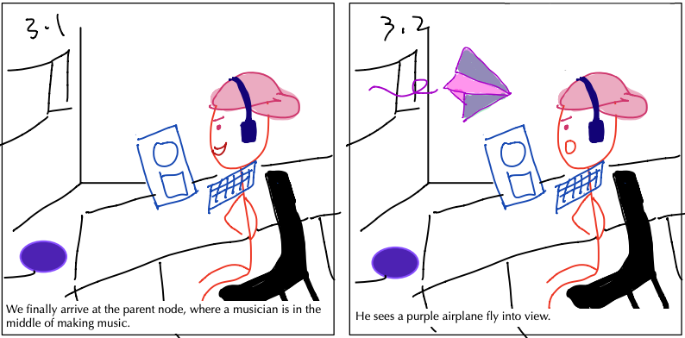
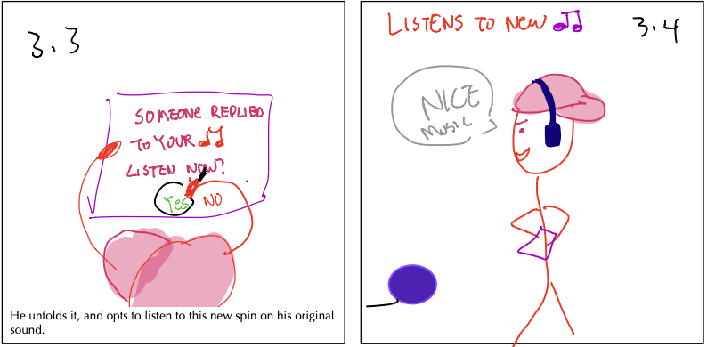
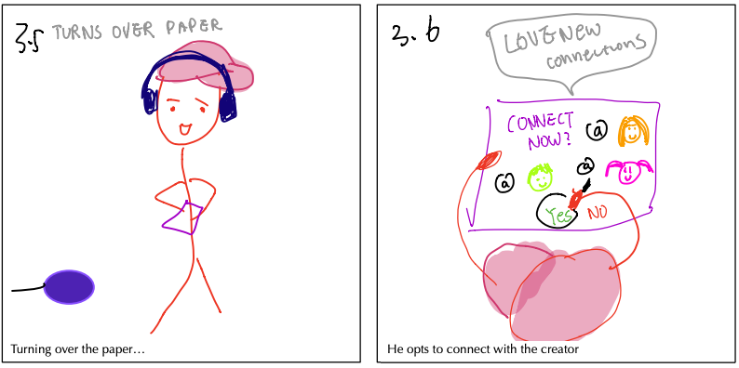
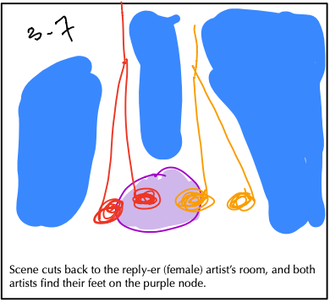
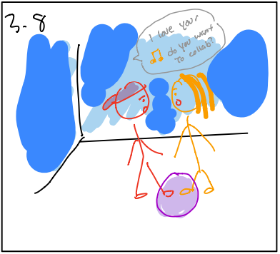
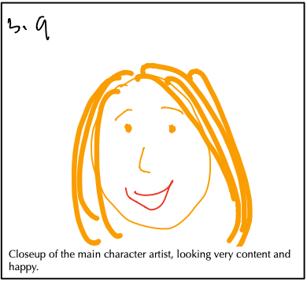
Track your soundbyte’s evolution [COMPLEX]
Scene 3
Connect with a remixer [COMPLEX]

